Slide 1

Materials used in regenerative medicine
The Gifted and Talented Development Centre of Tartu
Reedik Sõber & Rasmus Liira & Ksenia Kukuškina
Quantum Spin-Off project is funded by the European Commission. This communication reflects the views of the author,
and the Commission cannot be held responsible for any use which may be made of the information contained herein.

Slide 2
What are the advantages of regenerative medicine over traditional medicine?
Natural healing
Cell therapy
Organs
Conducting experiments

Slide 3
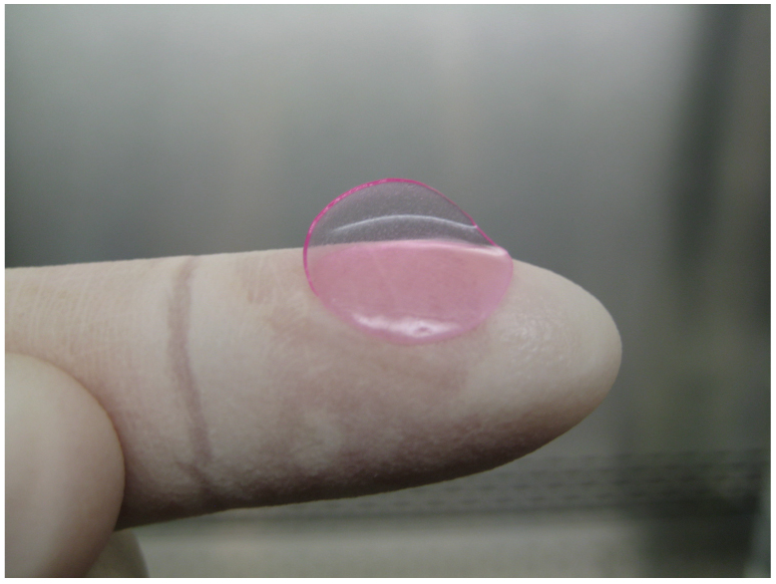
What are the advantages of regenerative medicine over traditional medicine?
Sangheeta Bhatia, MIT

Slide 4
How does nanotechnology promote regenerative medicine?
Creating microenvironments
Controlled release
Use of three-dimensional environments
New research methods

Slide 5
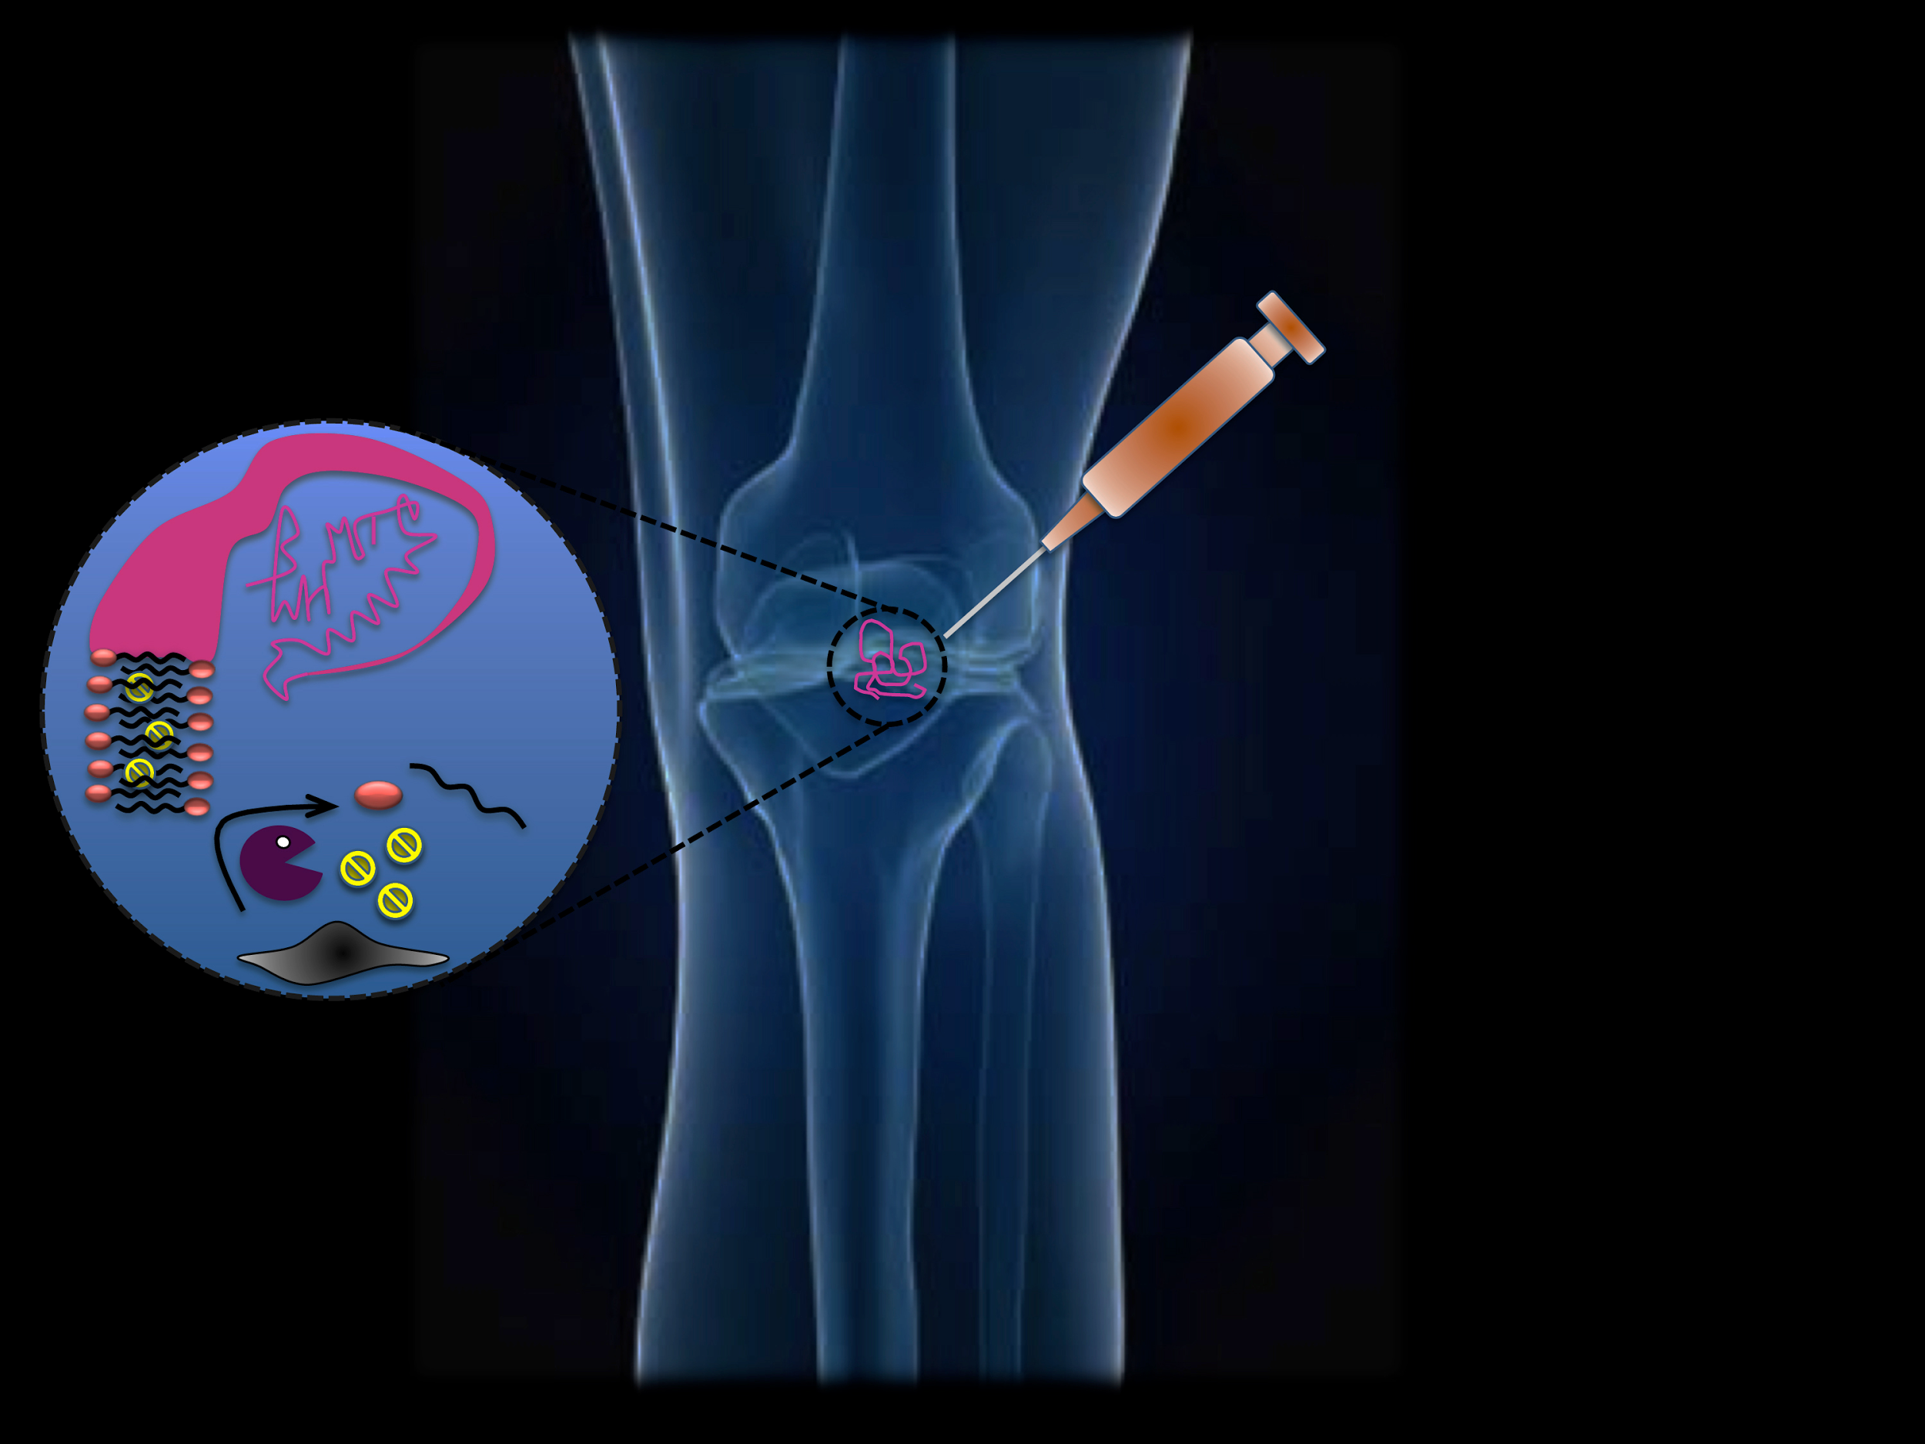
How does nanotechnology promote regenerative medicine?
Praveen Vemula, Karp lab, BWH

Slide 6
Research
“Synthetic biomaterials as instructive extracellular microenvironments for morphogenesis in tissue engineering”
Imitating natural ECM’s
Still simplified, but developing
Artificial ECM’s already in use

Slide 7
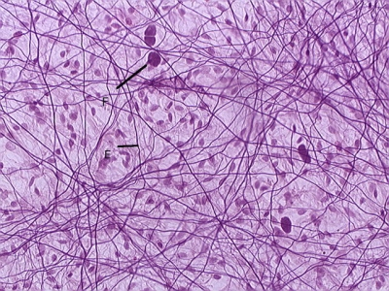
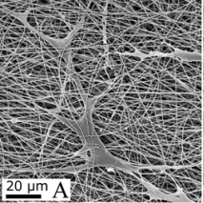
Research
Skin connective tissue
Matrix developed by Martin Järvekülg

Slide 8
Getting to know the problem
Communication with medical workers
Analysis of existing products
Description of ideal product

Slide 9
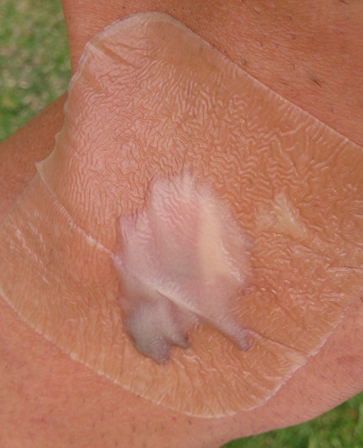
Getting to know the problem
Hydrocolloid dressing on wound

Slide 10
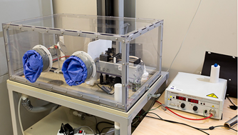
Product creation
Brainstorming
Matrix of crosslinked collagen
Zinc oxide nanoparticles
C-vitamin solution
Phospholipid coating
Electrospin, Tartu Nanolab

Slide 11
Business plan
High-quality substances, sterile packaging
Wide market through pharmacies
Advertisement, raising awareness about the field
Big capital, small running costs
Investments to start, later profits through a large market share

Slide 12
Contribution to society
New approach to wound treatment
Effective and affordable treatment option
Absence of side effects
Science popularization

Slide 13
Plans for the future
Experiments
Market evaluation
Investors and partners

Slide 14
Thank you for your attention!

